Slide 1
COMP 3711 Design and Analysis of Algorithms
Tutorial: Dynamic Programming 2D

Slide 2
COMP3711
The longest arithmetic progression problem

Slide 3
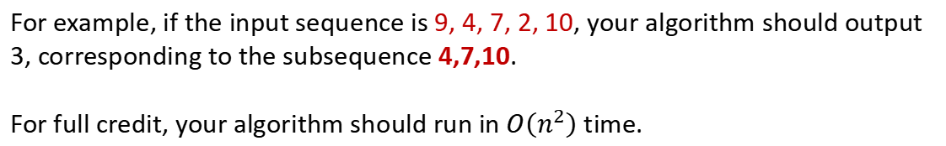
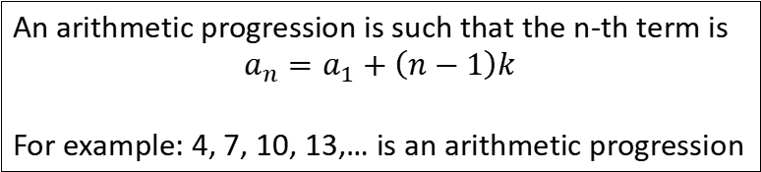
The Longest Arithmetic Progression
An arithmetic progression is such that the n-th term is
$$a_{n}=a_{1}+\left(n−1\right)k$$
For example: 4, 7, 10, 13,… is an arithmetic progression
Describe and analyze an efficient algorithm to find the length of the longest arithmetic progression in a sequence $A[1..n]$of $n$ integers.
For example, if the input sequence is 9, 4, 7, 2, 10, your algorithm should output 3, corresponding to the subsequence 4,7,10.
For full credit, your algorithm should run in$O\left(n^{2}\right)$ time.

Slide 4
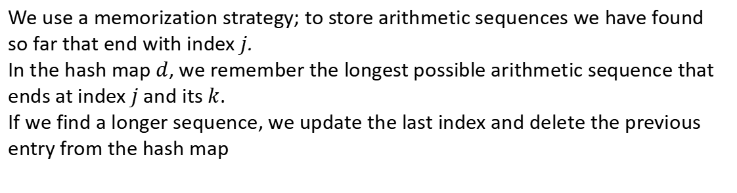
Solution
An arithmetic progression is such that the n-th term is
$$a_{n}=a_{1}+\left(n−1\right)k$$
For example: 4, 7, 10, 13,… is an arithmetic progression
Describe and analyze an efficient algorithm to find the length of the longest arithmetic progression in a sequence $A[1..n]$of $n$ integers.
We use a memorization strategy; to store arithmetic sequences we have found so far that end with index $j$.
In the hash map $d$, we remember the longest possible arithmetic sequence that ends at index $j$ and its $k$.
If we find a longer sequence, we update the last index and delete the previous entry from the hash map

Slide 5
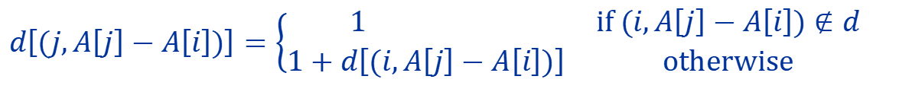

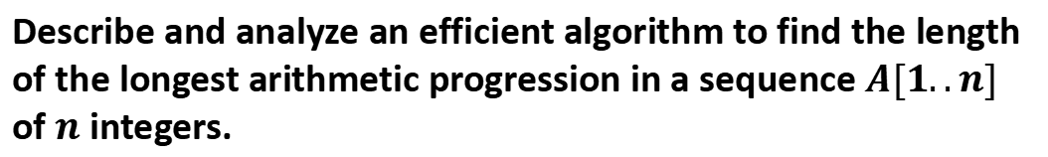
Solution
Describe and analyze an efficient algorithm to find the length of the longest arithmetic progression in a sequence $A[1..n]$ of $n$ integers.
Let $d[(i, A\left[j\right]−A\left[i\right])]$ be the longest arithmetic progression that ends and includes the element at $i$
Base Case: $d\left[(j,A\left[j\right]−A\left[1\right])\right]=1$
$$for j>1$$
General Case: If $i>1,$ and $j>i+1$
$$d\left[(j,A\left[j\right]−A\left[i\right])\right]=\left\{\begin{matrix}1 & if (i,A\left[j\right]−A\left[i\right])∉d \\ 1+d\left[(i,A\left[j\right]−A\left[i\right])\right] & otherwise\end{matrix}\right.$$
This can be implemented in $O\left(n^{2}\right)$time.

Slide 6


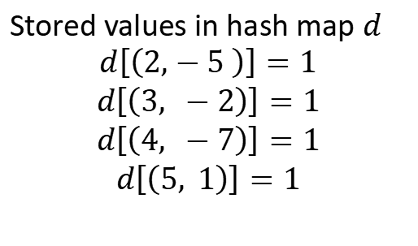
Example
Base Case: $d\left[(j,A\left[j\right]−A\left[1\right])\right]=1$
$$for j>1$$
General Case: If $i>1,$ and $j>i+1$
$$d\left[(j,A\left[j\right]−A\left[i\right])\right]=\left\{\begin{matrix}1 & if (i,A\left[j\right]−A\left[i\right])∉d \\ 1+d\left[(i,A\left[j\right]−A\left[i\right])\right] & otherwise\end{matrix}\right.$$
Stored values in hash map $d$
$$d\left[\left(2,−5 \right)\right]=1$$
$$d\left[\left(3, −2\right)\right]=1$$
$$d\left[\left(4, −7\right)\right]=1$$
$$d\left[\left(5, 1\right)\right]=1$$
Let $A=[9,4,7,2,10]$
$A=[9,4,7,2,10]$

Slide 7
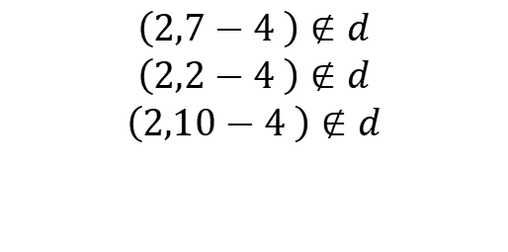
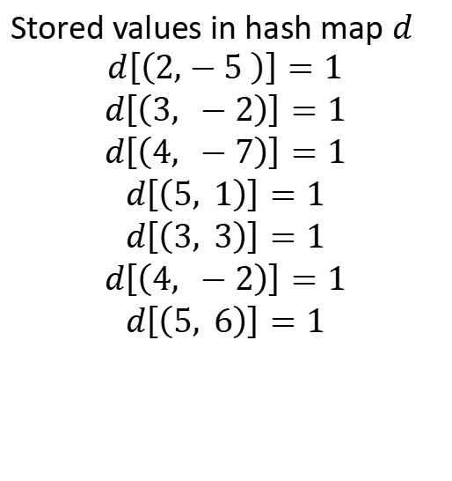
Example
Base Case: $d\left[(j,A\left[j\right]−A\left[1\right])\right]=1$
$$for j>1$$
General Case: If $i>1,$ and $j>i+1$
$$d\left[(j,A\left[j\right]−A\left[i\right])\right]=\left\{\begin{matrix}1 & if (i,A\left[j\right]−A\left[i\right])∉d \\ 1+d\left[(i,A\left[j\right]−A\left[i\right])\right] & otherwise\end{matrix}\right.$$
Stored values in hash map $d$
$$d\left[\left(2,−5 \right)\right]=1$$
$$d\left[\left(3, −2\right)\right]=1$$
$$d\left[\left(4, −7\right)\right]=1$$
$$d\left[\left(5, 1\right)\right]=1$$
$$d\left[\left(3, 3\right)\right]=1$$
$$d\left[\left(4, −2\right)\right]=1$$
$$d\left[\left(5, 6\right)\right]=1$$
Let $A=[9,4,7,2,10]$
$A=[9,4,7,2,10]$
$$\left(2,7−4 \right)∉d$$
$$\left(2,2−4 \right)∉d$$
$$\left(2,10−4 \right)∉d$$

Slide 8

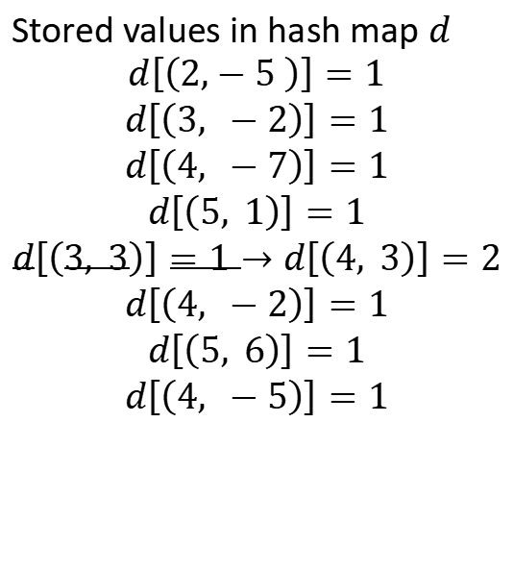
Example
Base Case: $d\left[(j,A\left[j\right]−A\left[1\right])\right]=1$
$$for j>1$$
General Case: If $i>1,$ and $j>i+1$
$$d\left[(j,A\left[j\right]−A\left[i\right])\right]=\left\{\begin{matrix}1 & if (i,A\left[j\right]−A\left[i\right])∉d \\ 1+d\left[(i,A\left[j\right]−A\left[i\right])\right] & otherwise\end{matrix}\right.$$
Stored values in hash map $d$
$$d\left[\left(2,−5 \right)\right]=1$$
$$d\left[\left(3, −2\right)\right]=1$$
$$d\left[\left(4, −7\right)\right]=1$$
$$d\left[\left(5, 1\right)\right]=1$$
$$d\left[\left(3, 3\right)\right]=1→d\left[\left(4, 3\right)\right]=2$$
$$d\left[\left(4, −2\right)\right]=1$$
$$d\left[\left(5, 6\right)\right]=1$$
$$d\left[\left(4, −5\right)\right]=1$$
Let $A=[9,4,7,2,10]$
$A=[9,4,7,2,10]$
$$\left(3,2−7 \right)∉d$$
$$\left(3,10−7 \right)∈d$$

Slide 9

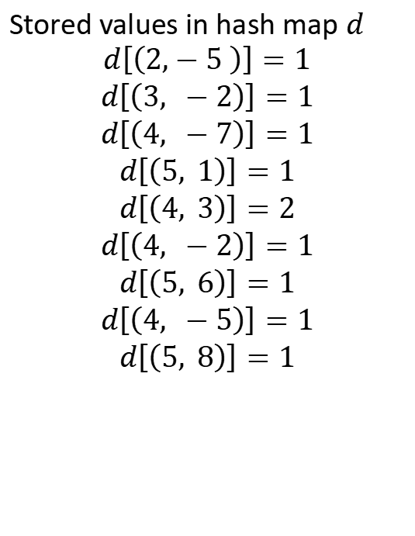
Example
Base Case: $d\left[(j,A\left[j\right]−A\left[1\right])\right]=1$
$$for j>1$$
General Case: If $i>1,$ and $j>i+1$
$$d\left[(j,A\left[j\right]−A\left[i\right])\right]=\left\{\begin{matrix}1 & if (i,A\left[j\right]−A\left[i\right])∉d \\ 1+d\left[(i,A\left[j\right]−A\left[i\right])\right] & otherwise\end{matrix}\right.$$
Stored values in hash map $d$
$$d\left[\left(2,−5 \right)\right]=1$$
$$d\left[\left(3, −2\right)\right]=1$$
$$d\left[\left(4, −7\right)\right]=1$$
$$d\left[\left(5, 1\right)\right]=1$$
$$d\left[\left(4, 3\right)\right]=2$$
$$d\left[\left(4, −2\right)\right]=1$$
$$d\left[\left(5, 6\right)\right]=1$$
$$d\left[\left(4, −5\right)\right]=1$$
$$d\left[\left(5, 8\right)\right]=1$$
Let $A=[9,4,7,2,10]$
$A=[9,4,7,2,10]$
$$\left(4,10−2 \right)∉d$$

Slide 10
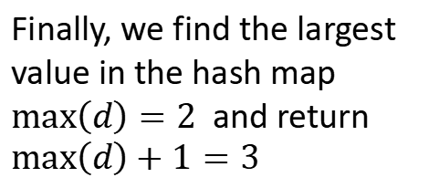
Example
Base Case: $d\left[(j,A\left[j\right]−A\left[1\right])\right]=1$
$$for j>1$$
General Case: If $i>1,$ and $j>i+1$
$$d\left[(j,A\left[j\right]−A\left[i\right])\right]=\left\{\begin{matrix}1 & if (i,A\left[j\right]−A\left[i\right])∉d \\ 1+d\left[(i,A\left[j\right]−A\left[i\right])\right] & otherwise\end{matrix}\right.$$
Stored values in hash map $d$
$$d\left[\left(2,−5 \right)\right]=1$$
$$d\left[\left(3, −2\right)\right]=1$$
$$d\left[\left(4, −7\right)\right]=1$$
$$d\left[\left(5, 1\right)\right]=1$$
$$d\left[\left(4, 3\right)\right]=2$$
$$d\left[\left(4, −2\right)\right]=1$$
$$d\left[\left(5, 6\right)\right]=1$$
$$d\left[\left(4, −5\right)\right]=1$$
$$d\left[\left(5, 8\right)\right]=1$$
Finally, we find the largest value in the hash map $max\left(d\right)=2$ and return $max\left(d\right)+1=3$

Slide 11
COMP3711: Design and Analysis of Algorithms
The Subset Sum Problem

Slide 12
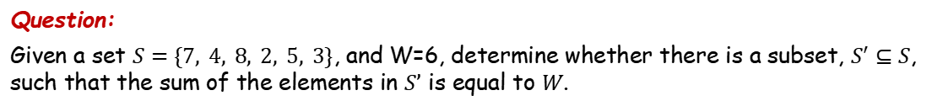
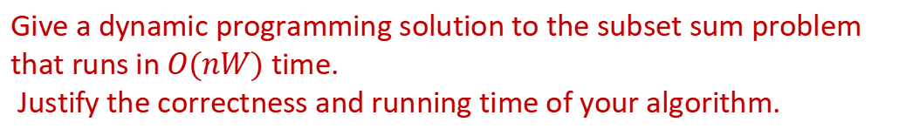
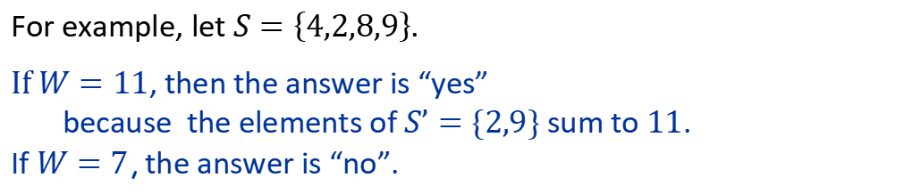
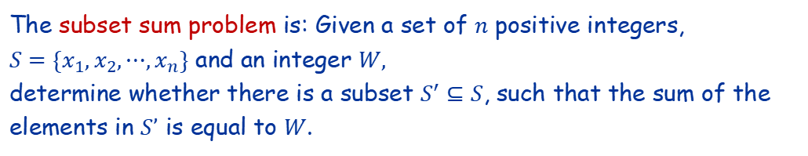
Question
The subset sum problem is: Given a set of $n$ positive integers, $S=\{x_{1},x_{2},⋯,x_{n}\}$ and an integer $W,$ determine whether there is a subset $S^{′}⊆S$, such that the sum of the elements in $S’$ is equal to $W$.
For example, let $S=\left\{4,2,8,9\right\}.$
If $W=11$, then the answer is “yes” because the elements of $S’=\{2,9\}$ sum to $11$. If $W=7$, the answer is “no”.
Question:
Given a set $S=\{7, 4, 8, 2, 5, 3\}$, and W=6, determine whether there is a subset, $S^{′}⊆S$, such that the sum of the elements in $S’$ is equal to $W$.
Give a dynamic programming solution to the subset sum problem that runs in $O(nW)$ time. Justify the correctness and running time of your algorithm.

Slide 13
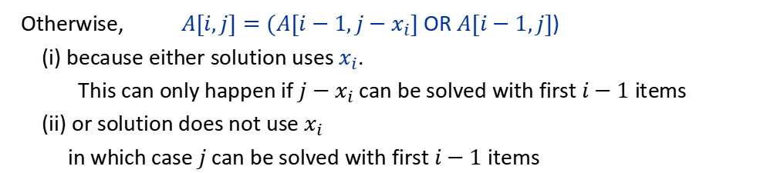
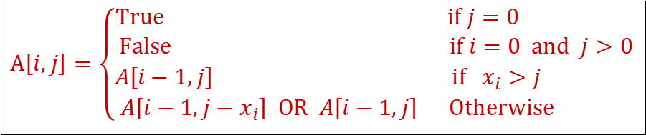
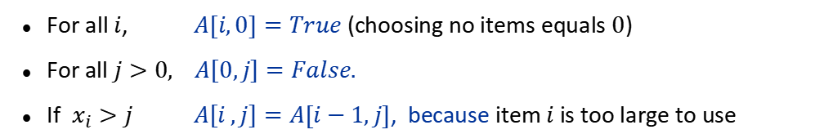
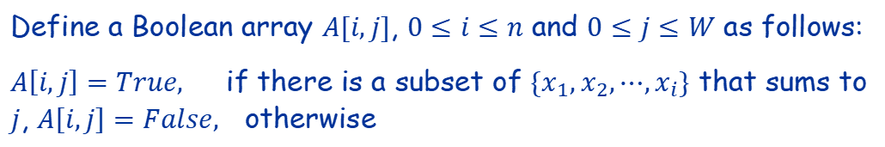
Solution
Define a Boolean array $A[i,j]$, $0≤i≤n$ and $0≤j≤W$ as follows:
$A\left[i,j\right]=True,$ if there is a subset of $\{x_{1},x_{2},⋯,x_{i}\}$ that sums to $j$, $A\left[i,j\right]=False,$ otherwise
Easy Cases:
For all $i$, $A[i,0]=True$ (choosing no items equals $0$)
For all $j>0,$ $A\left[0,j\right]=False.$
If $x_{i}>j$ $A\left[i ,j\right]=A[i−1,j]$, because item $i$ is too large to use
Otherwise, $A[i,j]=(A[i−1,j−x_{i}]$ OR $A[i−1,j]$) (i) because either solution uses $x_{i}$. This can only happen if $j−x_{i}$ can be solved with first $i−1$ items (ii) or solution does not use $x_{i}$ in which case $j$ can be solved with first $i−1$ items
$$A\left[i,j\right]=\left\{\begin{matrix}True & if j=0 \\ False & if i=0 and j>0 \\ A\left[i−1,j\right] & if{ x}_{i}>j \\ A\left[i−1,j−x_{i}\right] OR A\left[i−1,j\right] & Otherwise \end{matrix}\right.$$

Slide 14

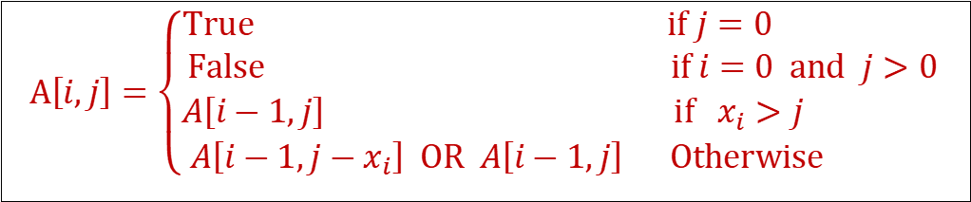
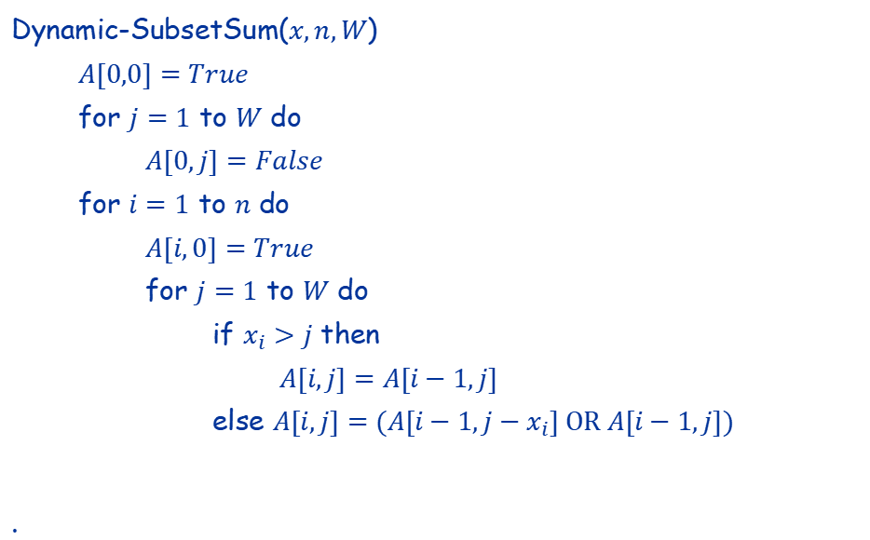
Solution
$$A\left[i,j\right]=\left\{\begin{matrix}True & if j=0 \\ False & if i=0 and j>0 \\ A\left[i−1,j\right] & if{ x}_{i}>j \\ A\left[i−1,j−x_{i}\right] OR A\left[i−1,j\right] & Otherwise \end{matrix}\right.$$
Dynamic-SubsetSum($x,n,W$)
$A[0,0]=True$
for $j=1$ to $W$ do
$A[0,j]=False$
for $i=1$ to $n$ do
$A[i,0]=True$
for $j=1$ to $W$ do
if $x_{i}>j$ then
$A[i,j]=A[i−1,j]$
else $A[i,j]=(A[i−1,j−x_{i}] \text{OR} A[i−1,j])$
.
It is easy to see that this runs in $O(nW)$ time.
There will be a solution if and only if $A\left[n,W\right]=True.$

Slide 15


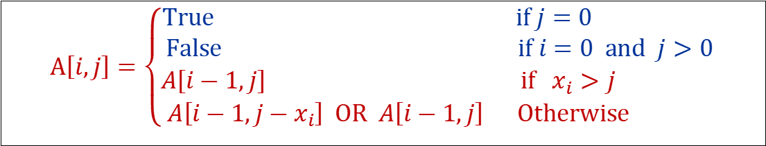
Example
$$A\left[i,j\right]=\left\{\begin{matrix}True & if j=0 \\ False & if i=0 and j>0 \\ A\left[i−1,j\right] & if{ x}_{i}>j \\ A\left[i−1,j−x_{i}\right] OR A\left[i−1,j\right] & Otherwise \end{matrix}\right.$$
Question:
Given a set $S=\{7, 4, 8, 2, 5, 3\}$, and W=6, determine whether there is a subset, $S^{′}⊆S$, such that the sum of the elements in $S’$ is equal to $W$.
Solution: we use a table to store A
i \ j | 0 | 1 | 2 | 3 | 4 | 5 | 6
0 | T | F | F | F | F | F | F
1 | T
2 | T
3 | T
4 | T
5 | T
6 | T
$i=0, j>0$
$$j=0$$

Slide 16


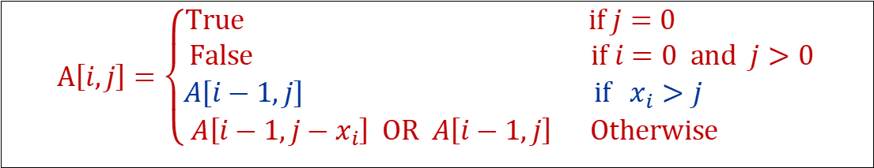
Example
$$A\left[i,j\right]=\left\{\begin{matrix}True & if j=0 \\ False & if i=0 and j>0 \\ A\left[i−1,j\right] & if{ x}_{i}>j \\ A\left[i−1,j−x_{i}\right] OR A\left[i−1,j\right] & Otherwise \end{matrix}\right.$$
Question:
Given a set $S=\{7, 4, 8, 2, 5, 3\}$, and W=6, determine whether there is a subset, $S^{′}⊆S$, such that the sum of the elements in $S’$ is equal to $W$.
Solution: we use a table to store A
i \ j | 0 | 1 | 2 | 3 | 4 | 5 | 6
0 | T | F | F | F | F | F | F
1 | T | F | F | F | F | F | F
2 | T
3 | T
4 | T
5 | T
6 | T
$x_{1}=7>j=1,..6$
so, for all j
$A\left[1,j\right]=A[0,j]$

Slide 17







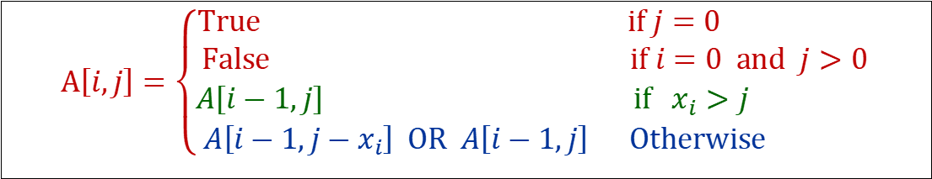
Example
$$A\left[i,j\right]=\left\{\begin{matrix}True & if j=0 \\ False & if i=0 and j>0 \\ A\left[i−1,j\right] & if{ x}_{i}>j \\ A\left[i−1,j−x_{i}\right] OR A\left[i−1,j\right] & Otherwise \end{matrix}\right.$$
Question:
Given a set $S=\{7, 4, 8, 2, 5, 3\}$, and W=6, determine whether there is a subset, $S^{′}⊆S$, such that the sum of the elements in $S’$ is equal to $W$.
Solution: we use a table to store A
$x_{2}=4≤j=4,5,6$
i \ j | 0 | 1 | 2 | 3 | 4 | 5 | 6
0 | T | F | F | F | F | F | F
1 | T | F | F | F | F | F | F
2 | T | F | F | F | T | F | F
3 | T
4 | T
5 | T
6 | T
so, when $j=4,5,6$
$A\left[2,j\right]=(A\left[1,j−4\right] OR A\left[1,j\right])$
e.g. $A\left[2,4\right]=(A\left[1,0\right] OR A\left[1,4\right])$
$= T OR F =T$
$x_{2}=4>j=1,2,3$
so, when $j=1,2,3$
$A\left[2,j\right]=A[1,j]$

Slide 18


Example
$$A\left[i,j\right]=\left\{\begin{matrix}True & if j=0 \\ False & if i=0 and j>0 \\ A\left[i−1,j\right] & if{ x}_{i}>j \\ A\left[i−1,j−x_{i}\right] OR A\left[i−1,j\right] & Otherwise \end{matrix}\right.$$
Question:
Given a set $S=\{7, 4, 8, 2, 5, 3\}$, and W=6, determine whether there is a subset, $S^{′}⊆S$, such that the sum of the elements in $S’$ is equal to $W$.
Solution: we use a table to store A
i \ j | 0 | 1 | 2 | 3 | 4 | 5 | 6
0 | T | F | F | F | F | F | F
1 | T | F | F | F | F | F | F
2 | T | F | F | F | T | F | F
3 | T | F | F | F | T | F | F
4 | T
5 | T
6 | T
$x_{3}=8>j=1,..6$
So, for all j $A\left[3,j\right]=A[2,j]$

Slide 19





Example
$$A\left[i,j\right]=\left\{\begin{matrix}True & if j=0 \\ False & if i=0 and j>0 \\ A\left[i−1,j\right] & if{ x}_{i}>j \\ A\left[i−1,j−x_{i}\right] OR A\left[i−1,j\right] & Otherwise \end{matrix}\right.$$
Question:
Given a set $S=\{7, 4, 8, 2, 5, 3\}$, and W=6, determine whether there is a subset, $S^{′}⊆S$, such that the sum of the elements in $S’$ is equal to $W$.
Solution: we use a table to store A
i \ j | 0 | 1 | 2 | 3 | 4 | 5 | 6
0 | T | F | F | F | F | F | F
1 | T | F | F | F | F | F | F
2 | T | F | F | F | T | F | F
3 | T | F | F | F | T | F | F
4 | T | F | T | F | T | F | T
5 | T
6 | T
$x_{4}=2≤j=2,3,4,5,6$
So, when j = 2, …, 6
$$A\left[4,j\right]=(A\left[3,j−2\right] OR A\left[3,j\right] )$$
e.g. $A\left[4,2\right] =\left(A\left[3,0\right] OR A\left[3,2\right]\right)$
$$=T OR F=T$$
$x_{4}=2>j=1$
so $A\left[4,1\right]=A\left[3,1\right]=F$

Slide 20

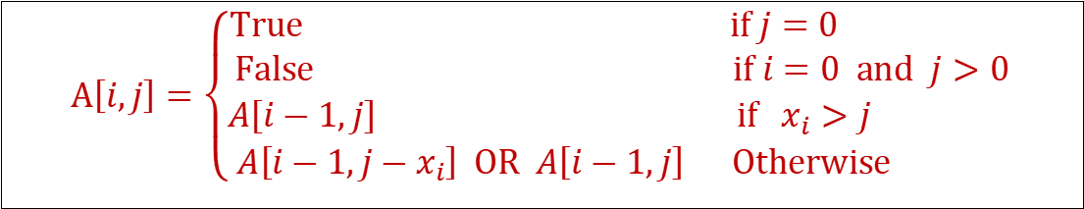
Example
$$A\left[i,j\right]=\left\{\begin{matrix}True & if j=0 \\ False & if i=0 and j>0 \\ A\left[i−1,j\right] & if{ x}_{i}>j \\ A\left[i−1,j−x_{i}\right] OR A\left[i−1,j\right] & Otherwise \end{matrix}\right.$$
Question:
Given a set $S=\{7, 4, 8, 2, 5, 3\}$, and W=6, determine whether there is a subset, $S^{′}⊆S$, such that the sum of the elements in $S’$ is equal to $W$.
Solution: we use a table to store A
i \ j | 0 | 1 | 2 | 3 | 4 | 5 | 6
0 | T | F | F | F | F | F | F
1 | T | F | F | F | F | F | F
2 | T | F | F | F | T | F | F
3 | T | F | F | F | T | F | F
4 | T | F | T | F | T | F | T
5 | T | F | T | F | T | T | T
6 | T | F | T | T | T | T | T
Fill the table
$Return:A\left[ 6, 6\right]=True$

Slide 21
COMP3711: Design and Analysis of Algorithms
The House Painting Problem

Slide 22
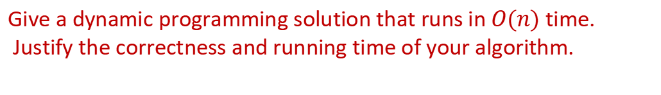
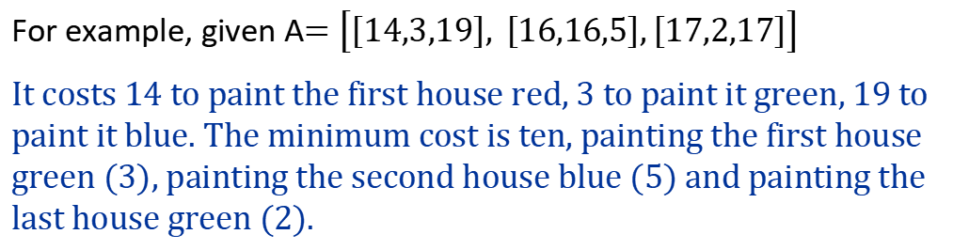
Question
Given a row of houses, each house can be painted red, green or blue. The cost of painting the house depends on the house and the color. No house should be painted the same color as its neighbors. What is the minimum cost to paint all the houses?
For example, given A$=\left[\left[14,3,19\right], \left[16,16,5\right],\left[17,2,17\right]\right]$
It costs 14 to paint the first house red, 3 to paint it green, 19 to paint it blue. The minimum cost is ten, painting the first house green (3), painting the second house blue (5) and painting the last house green (2).
Give a dynamic programming solution that runs in $O(n)$ time. Justify the correctness and running time of your algorithm.
A = [[17,2,17], [8,4,10], [6,3,19], [4,8,12]]

Slide 23
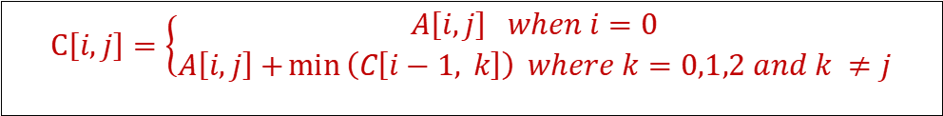
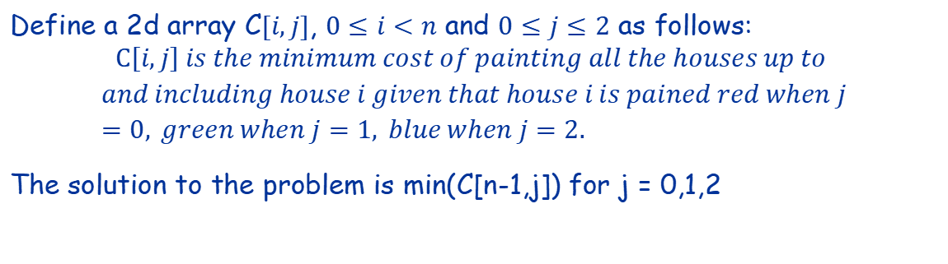
Solution
Define a 2d array C$[i,j]$, $0≤i<n$ and $0≤j≤2$ as follows:
$$C\left[i,j\right] is the minimum cost of painting all the houses up to$$
$$and including house i given that house i is pained red when j=0, green when j=1, blue when j=2.$$
The solution to the problem is min(C[n-1,j]) for j = 0,1,2
$$C\left[i,j\right]=\left\{\begin{aligned}A\left[i,j\right] when i=0 \\ A\left[i,j\right]+\min\left(C\left[i−1, k\right]\right) where k=0,1,2 and k ≠j\end{aligned}\right.$$

Slide 24
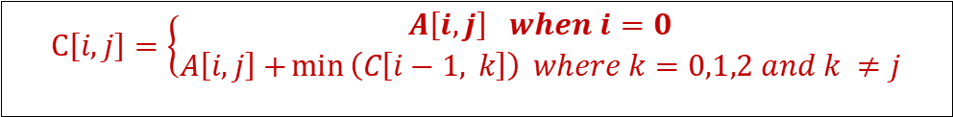
Example
Given A = [[17,2,17], [8,4,10], [6,3,19], [4,8,12]].
$$C\left[i,j\right]=\left\{\begin{aligned}A\left[i,j\right] when i=0 \\ A\left[i,j\right]+\min\left(C\left[i−1, k\right]\right) where k=0,1,2 and k ≠j\end{aligned}\right.$$
i \ j | 0 | 1 | 2
0 | 17 | 2 | 17
1
2
3

Slide 25
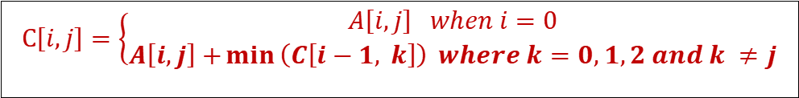
Example
Given A = [[17,2,17], [8,4,10], [6,3,19], [4,8,12]].
$$C\left[i,j\right]=\left\{\begin{aligned}A\left[i,j\right] when i=0 \\ A\left[i,j\right]+\min\left(C\left[i−1, k\right]\right) where k=0,1,2 and k ≠j\end{aligned}\right.$$
i \ j | 0 | 1 | 2
0 | 17 | 2 | 17
1 | 8 + min(2, 17)
2
3

Slide 26
Example
Given A = [[17,2,17], [8,4,10], [6,3,19], [4,8,12]].
$$C\left[i,j\right]=\left\{\begin{aligned}A\left[i,j\right] when i=0 \\ A\left[i,j\right]+\min\left(C\left[i−1, k\right]\right) where k=0,1,2 and k ≠j\end{aligned}\right.$$
i \ j | 0 | 1 | 2
0 | 17 | 2 | 17
1 | 10 | 4 + min(17,17)
2
3

Slide 27
Example
Given A = [[17,2,17], [8,4,10], [6,3,19], [4,8,12]].
$$C\left[i,j\right]=\left\{\begin{aligned}A\left[i,j\right] when i=0 \\ A\left[i,j\right]+\min\left(C\left[i−1, k\right]\right) where k=0,1,2 and k ≠j\end{aligned}\right.$$
i \ j | 0 | 1 | 2
0 | 17 | 2 | 17
1 | 10 | 21 | 10 + min(17,2)
2
3

Slide 28
Example
Given A = [[17,2,17], [8,4,10], [6,3,19], [4,8,12]].
$$C\left[i,j\right]=\left\{\begin{aligned}A\left[i,j\right] when i=0 \\ A\left[i,j\right]+\min\left(C\left[i−1, k\right]\right) where k=0,1,2 and k ≠j\end{aligned}\right.$$
i \ j | 0 | 1 | 2
0 | 17 | 2 | 17
1 | 10 | 21 | 12
2
3

Slide 29
Example
Given A = [[17,2,17], [8,4,10], [6,3,19], [4,8,12]].
$$C\left[i,j\right]=\left\{\begin{aligned}A\left[i,j\right] when i=0 \\ A\left[i,j\right]+\min\left(C\left[i−1, k\right]\right) where k=0,1,2 and k ≠j\end{aligned}\right.$$
i \ j | 0 | 1 | 2
0 | 17 | 2 | 17
1 | 10 | 21 | 12
2 | 6 + min(21,12)
3

Slide 30
Example
Given A = [[17,2,17], [8,4,10], [6,3,19], [4,8,12]].
$$C\left[i,j\right]=\left\{\begin{aligned}A\left[i,j\right] when i=0 \\ A\left[i,j\right]+\min\left(C\left[i−1, k\right]\right) where k=0,1,2 and k ≠j\end{aligned}\right.$$
i \ j | 0 | 1 | 2
0 | 17 | 2 | 17
1 | 10 | 21 | 12
2 | 18 | 3 + min(10,12)
3

Slide 31
Example
Given A = [[17,2,17], [8,4,10], [6,3,19], [4,8,12]].
$$C\left[i,j\right]=\left\{\begin{aligned}A\left[i,j\right] when i=0 \\ A\left[i,j\right]+\min\left(C\left[i−1, k\right]\right) where k=0,1,2 and k ≠j\end{aligned}\right.$$
i \ j | 0 | 1 | 2
0 | 17 | 2 | 17
1 | 10 | 21 | 12
2 | 18 | 13 | 19+min(10,21)
3

Slide 32
Example
Given A = [[17,2,17], [8,4,10], [6,3,19], [4,8,12]].
$$C\left[i,j\right]=\left\{\begin{aligned}A\left[i,j\right] when i=0 \\ A\left[i,j\right]+\min\left(C\left[i−1, k\right]\right) where k=0,1,2 and k ≠j\end{aligned}\right.$$
i \ j | 0 | 1 | 2
0 | 17 | 2 | 17
1 | 10 | 21 | 12
2 | 18 | 13 | 29
3

Slide 33
Example
Given A = [[17,2,17], [8,4,10], [6,3,19], [4,8,12]].
$$C\left[i,j\right]=\left\{\begin{aligned}A\left[i,j\right] when i=0 \\ A\left[i,j\right]+\min\left(C\left[i−1, k\right]\right) where k=0,1,2 and k ≠j\end{aligned}\right.$$
i \ j | 0 | 1 | 2
0 | 17 | 2 | 17
1 | 10 | 21 | 12
2 | 18 | 13 | 29
3 | 4 + min(13,29)

Slide 34
Example
Given A = [[17,2,17], [8,4,10], [6,3,19], [4,8,12]].
$$C\left[i,j\right]=\left\{\begin{aligned}A\left[i,j\right] when i=0 \\ A\left[i,j\right]+\min\left(C\left[i−1, k\right]\right) where k=0,1,2 and k ≠j\end{aligned}\right.$$
i \ j | 0 | 1 | 2
0 | 17 | 2 | 17
1 | 10 | 21 | 12
2 | 18 | 13 | 29
3 | 17 | 8+min(18,29)

Slide 35
Example
Given A = [[17,2,17], [8,4,10], [6,3,19], [4,8,12]].
$$C\left[i,j\right]=\left\{\begin{aligned}A\left[i,j\right] when i=0 \\ A\left[i,j\right]+\min\left(C\left[i−1, k\right]\right) where k=0,1,2 and k ≠j\end{aligned}\right.$$
i \ j | 0 | 1 | 2
0 | 17 | 2 | 17
1 | 10 | 21 | 12
2 | 18 | 13 | 29
3 | 17 | 26 | 12 + min(18,13)

Slide 36
Example
Given A = [[17,2,17], [8,4,10], [6,3,19], [4,8,12]].
$$C\left[i,j\right]=\left\{\begin{aligned}A\left[i,j\right] when i=0 \\ A\left[i,j\right]+\min\left(C\left[i−1, k\right]\right) where k=0,1,2 and k ≠j\end{aligned}\right.$$
i \ j | 0 | 1 | 2
0 | 17 | 2 | 17
1 | 10 | 21 | 12
2 | 18 | 13 | 29
3 | 17 | 26 | 25

Slide 37
Example
Given A = [[17,2,17], [8,4,10], [6,3,19], [4,8,12]].
$$C\left[i,j\right]=\left\{\begin{aligned}A\left[i,j\right] when i=0 \\ A\left[i,j\right]+\min\left(C\left[i−1, k\right]\right) where k=0,1,2 and k ≠j\end{aligned}\right.$$
i \ j | 0 | 1 | 2
0 | 17 | 2 | 17
1 | 10 | 21 | 12
2 | 18 | 13 | 29
3 | 17 | 26 | 25

